Slide 1
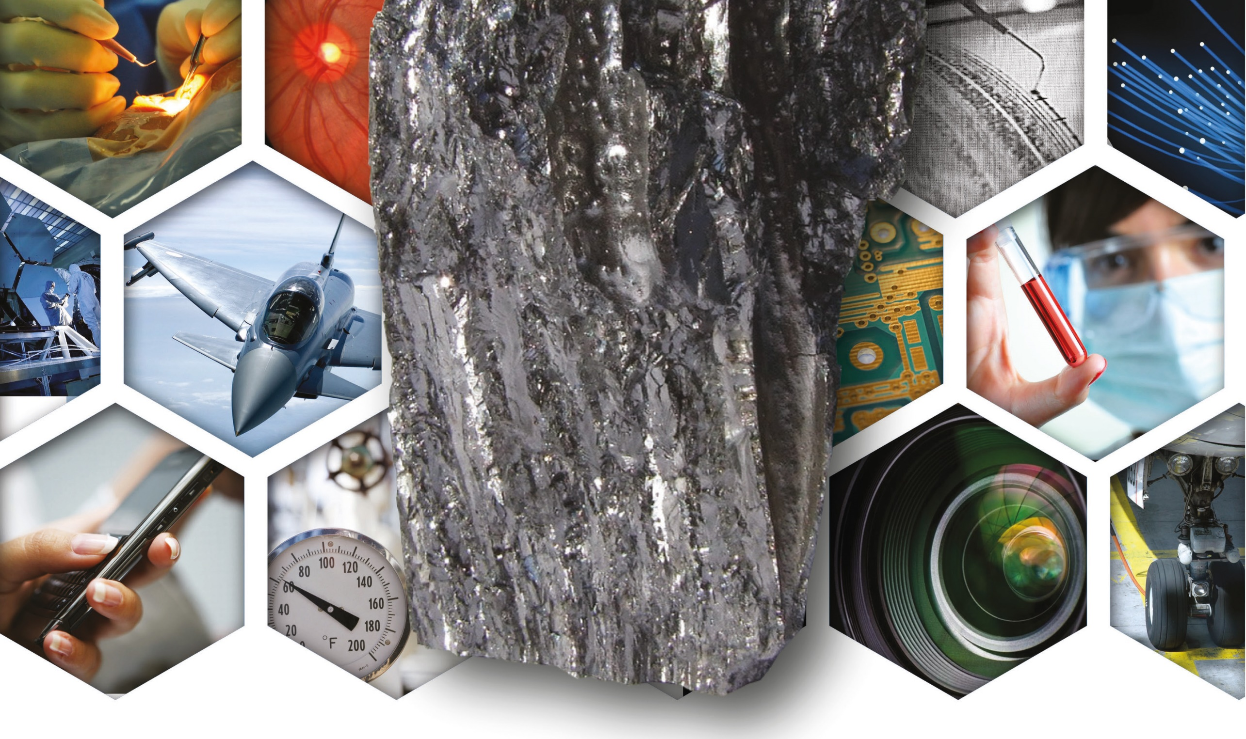
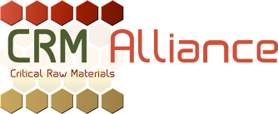
EU's Initiative to Promote More Investment in Antimony Mining Sites
Maurits Bruggink, Secretary General, Critical Raw Material Alliance

Slide 2
About Us
The Critical Raw Materials Alliance (CRM Alliance) has been created by industry to advocate the importance of CRMs for the European economy and to promote a strong European CRM policy.
We are the representative body of primary producers, traders, users and associations of CRMs and the voice of CRMs in Europe.
We also oversee an MEP Interest Group on Critical Raw Materials to connect industry with policy-makers through bi-annual political luncheon events.

Slide 3
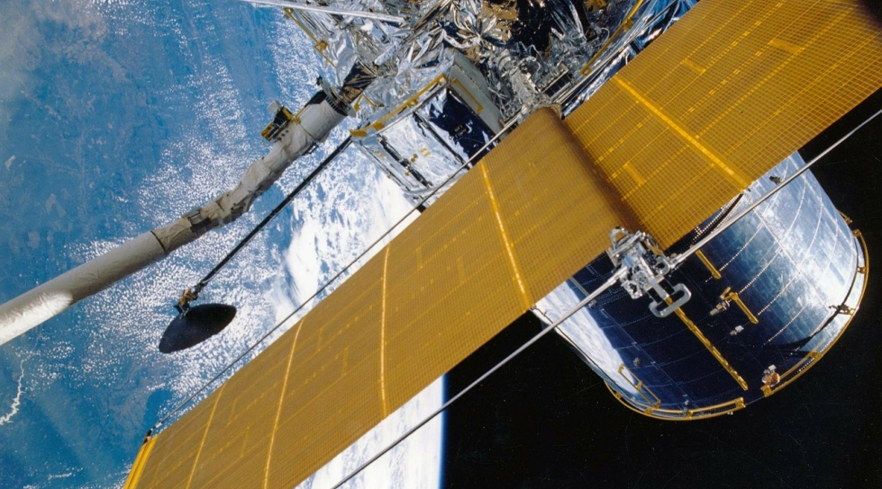
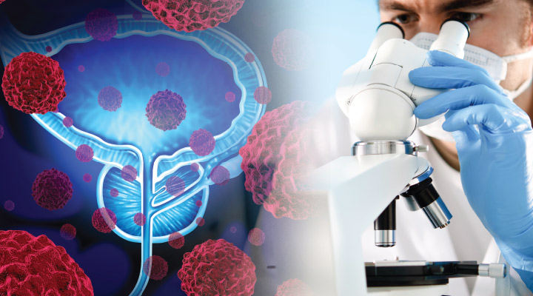
What are Critical Raw Materials?
Are strategically & economically important for key sectors of the EU economy: consumer electronics, environmental technologies, automotive, chemicals, aerospace, defence etc.
Have a high-risk associated with their supply – EU is heavily dependent on third country imports for several CRMs.
A lack of viable substitutes - due to the very unique and reliable properties, substitution is not a viable option, especially in high-tech applications which require a high-standard of performance and specification (often critical for safety).
27 CRMs on 2017 list: Antimony, Beryllium, Borates, Cobalt, Coking Coal, Fluorspar, Gallium, Germanium, Indium, Magnesium, Natural Graphite, Niobium, Phosphate Rock, Silicon Metal, Tungsten, Platinum Group Metals, Light Rare Earths and Heavy Rare Earths, Baryte, Bismuth, Hafnium, Helium, Natural Rubber, Phosphorus, Scandium, Tantalum, and Vanadium.

Slide 4
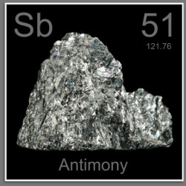
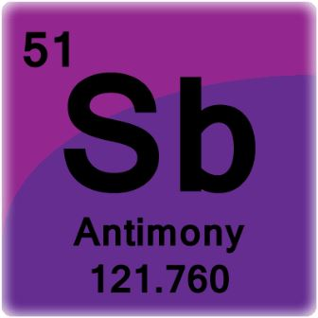
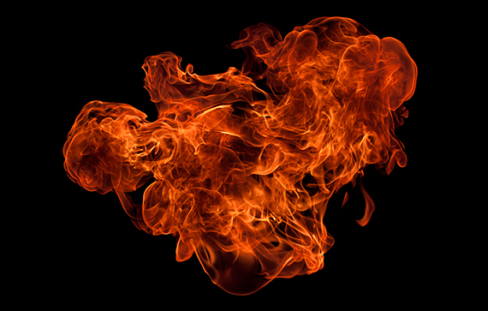
What is Antimony?
(Chemical Symbol Sb) is a soft, lustrous, silver-grey metalloid.
Has a relatively low melting point of 630°C and a density of 6.697 g/cm^{3.}
Found in over 100 different mineral species, typically in association with elements such as mercury, silver and gold.
Principal ore mineral of Antimony is stibnite.
Main applications are as a flame retardant and in the manufacture of lead-acid batteries.

Slide 5
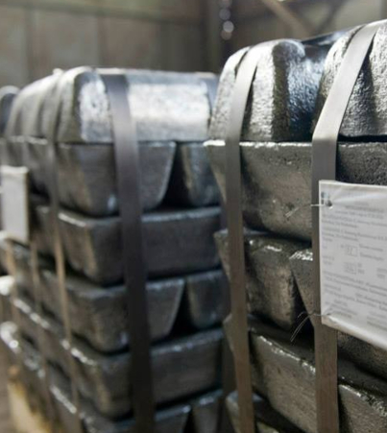
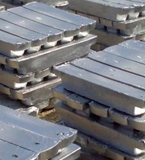
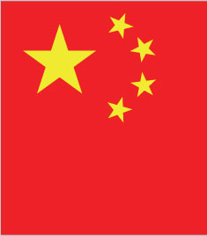
What Makes Antimony Critical?
High-Supply Risk - EU is 100% dependent upon imports, with 90% of all EU imports of Unwrought Antimony & 65% of Antimony Trioxide coming from China.
Economic Importance – Used in the production of flame retardants, lead-acid batteries, lead alloys, plastics and glass and ceramics.
Lack of Viable Substitutes – Any substitution of Antimony, in particular in its main applications, such as in flame retardants would be associated with a price and/or performance penalty.
Low End-of-Life Recycling Input Rate – E.O.L recycling rate is estimated at 28% (MSA).

Slide 6
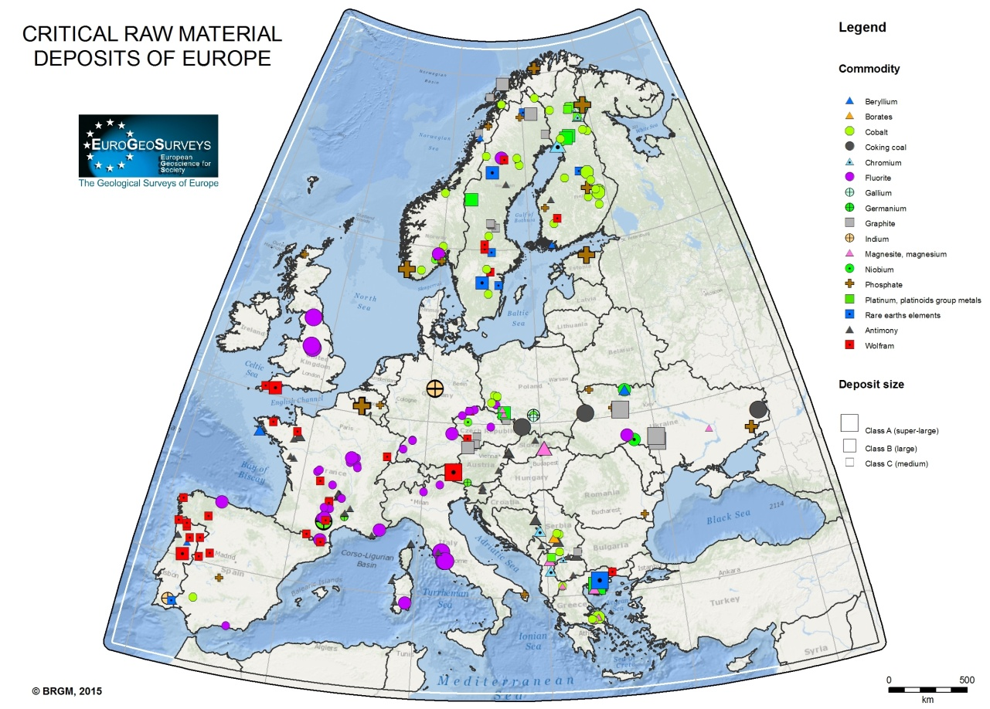
What about Antimony in Europe?
There is currently no primary extraction of antimony ores and concentrates in the EU
Six European countries are known to have antimony resources (France, Germany, Sweden, Finland, Slovakia and Greece)
Most resources in Europe are based on historic estimates and are of little current economic interest
Average EU imports of antimony trioxide (ATO) and unwrought antimony metal 2010-2014 : 65 % of ATO imports and almost 90 % of unwrought antimony metal imports came from China ⁴
The EU does produce ATO; mainly in Belgium, France, Spain and Italy
World antimony production (tonnes): 42,833 (average for 2010-2014) ⁵
Consumption of unwrought antimony metal in Europe (2010–2014) :18,200 tonnes per annum. ⁶
4: Eurostat
5: Critical Raw Materials Factsheets 2017
6: Critical Raw Materials Factsheets 2017

Slide 7
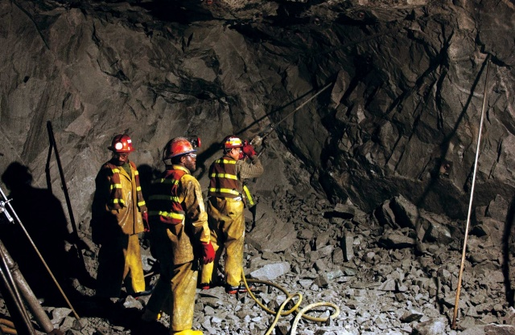
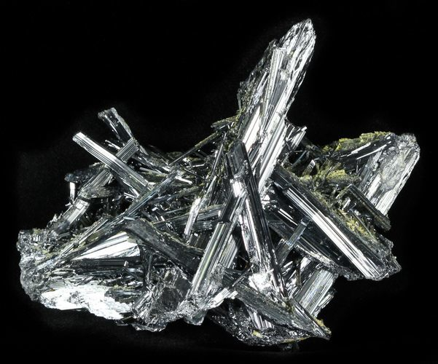
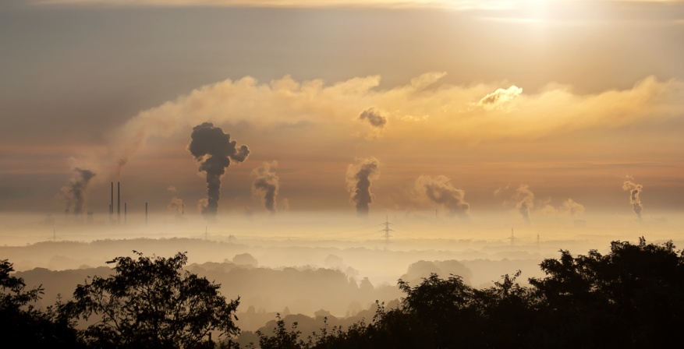
World Antimony reserves (2015):
1. China (47.8 %), 2.Russia (17.61 %), 3. Bolivia (15.6 %), 4. Australia (7.05%), 5. USA (3.02%)¹
World Antimony production (2016):
1. China (76.9%), 2. Russia (6.9%), 3. Tajikistan (6.2%), 4.Bolivia (3.1%), 5. Australia (2.7%)²
World’s Antimony exporters (2016):
1. China (37%), 2. India (10 %), 3. Singapore (9.6%), 4. Mexico (7.9%), 5. USA (6.4 %)³
1: US Geological Survey 2: US Geological Survey
3: World Atlas

Slide 8
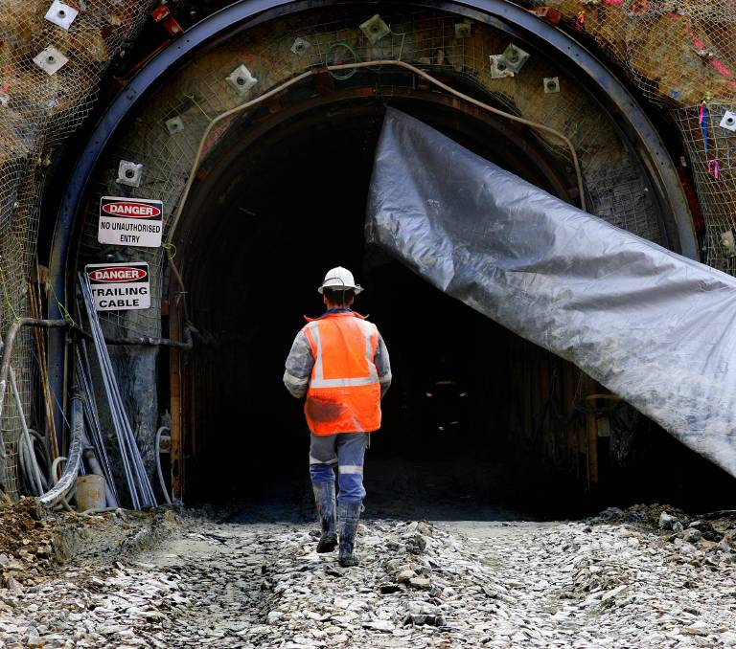
Obstacles to mining (Antimony) in Europe
Low level of investment: competition for land use, high investment costs, a heavy licensing process (potentially overlapping and even conflicting requirements) and compliance with stringent environmental law
Exploration projects generally do not result into an opening of a mine
Generation of waste and large tailings as well as environmental impacts
Low public acceptance of extractive activities in the EU as compared with other economic sectors: overall trust below 50%
Inferior costs in non-EU countries

Slide 9
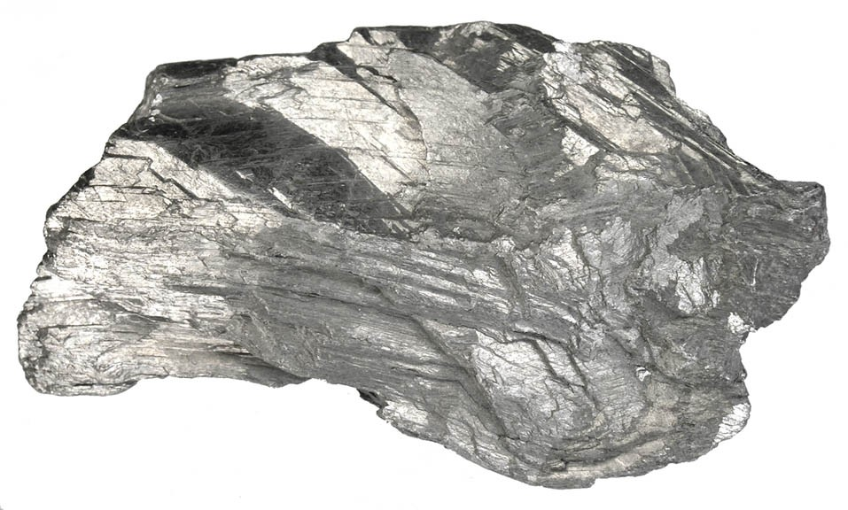
Ways to improve mining investment climate in Europe
Recovery of primary and secondary raw materials from extracted materials, old mine waste disposal sites and end-of life products
Rehabilitation of old sites and application of modern technologies and techniques
Facilitating public acceptance
Transparency on Antimony’ s availability in the EU
Coordination and implementation of minerals policies at different levels (EU, MS regional, local) and horizontally with other sectorial policies to avoid contradiction and overlapping
Strengthening the exchange of best practices and related regulation among Member States to streamline the permitting procedure along the whole chain of mining activities

Slide 10
Avenue Marnix 30 1000 Brussels Belgium
CONTACT US
Email address: mb@crmalliance.org
Critical Raw Materials Alliance

